Slide 1
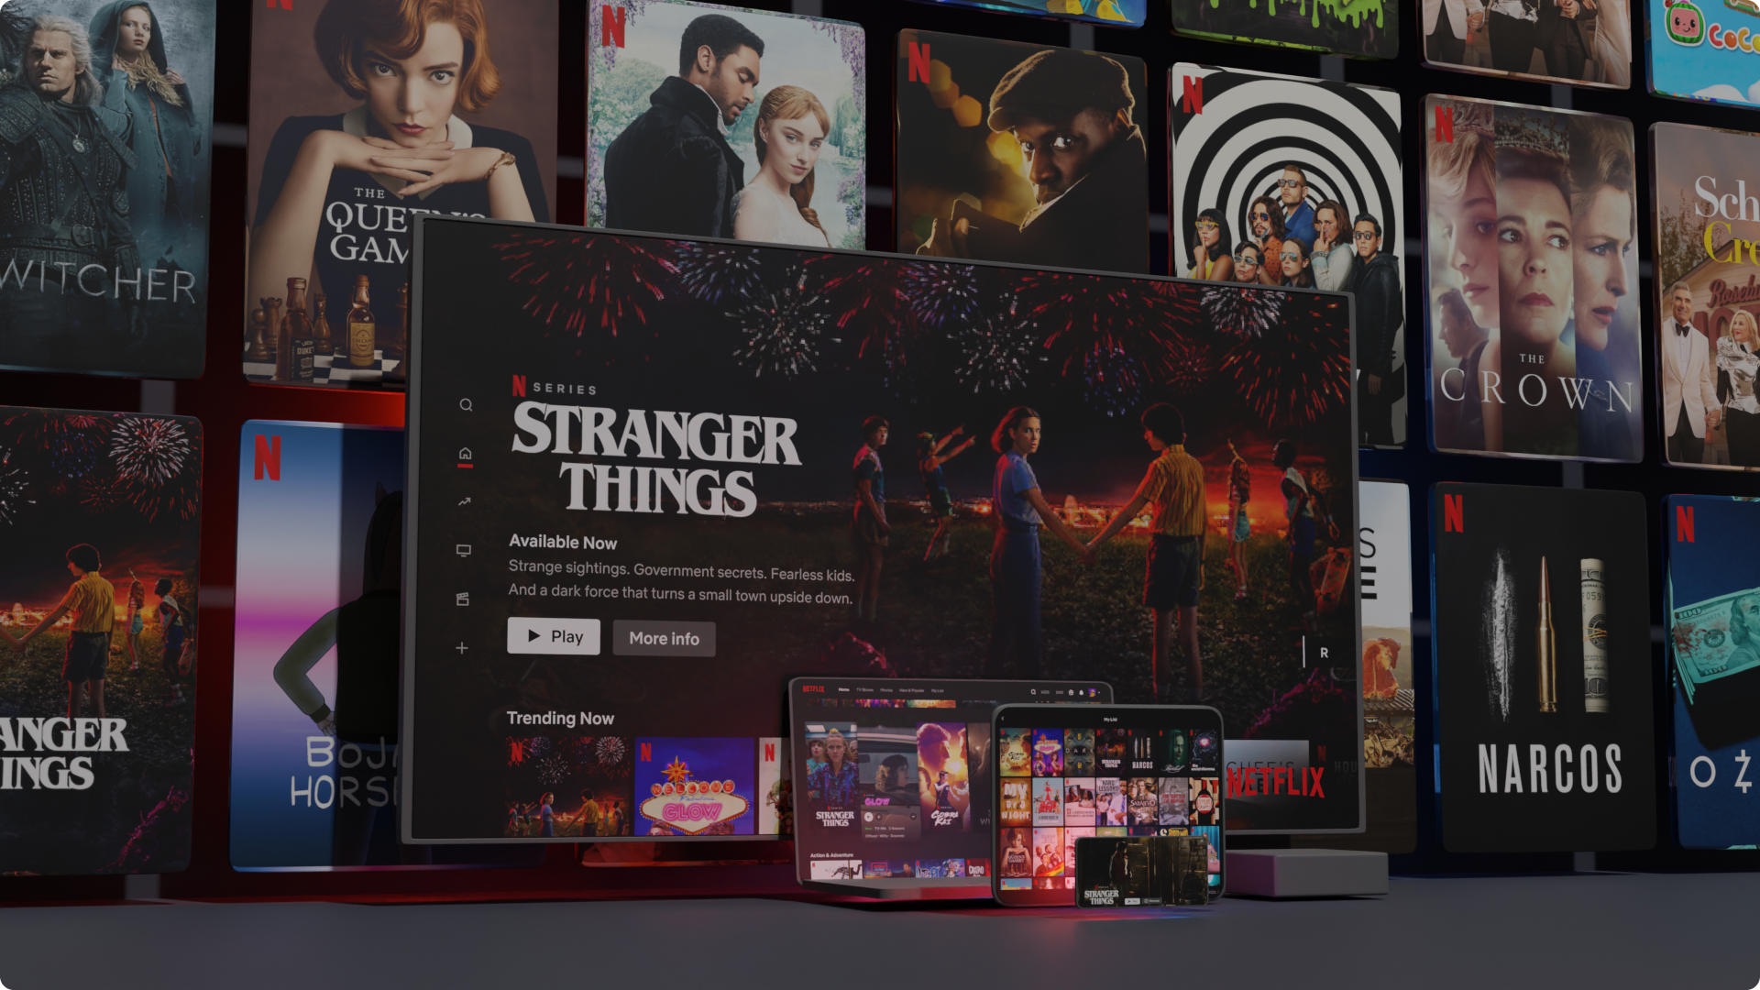

03.

Slide 2


Then and Now
A BIT OF HISTORY…
Started in 1997 by Reed Hastings & Marc Randolph in Scotts Valley, CA
Initially Netflix let people select a movie online to “rent” and return via U.S. mail
Their main competition was video rental stores (e.g., Blockbuster, Family Video)

Slide 3
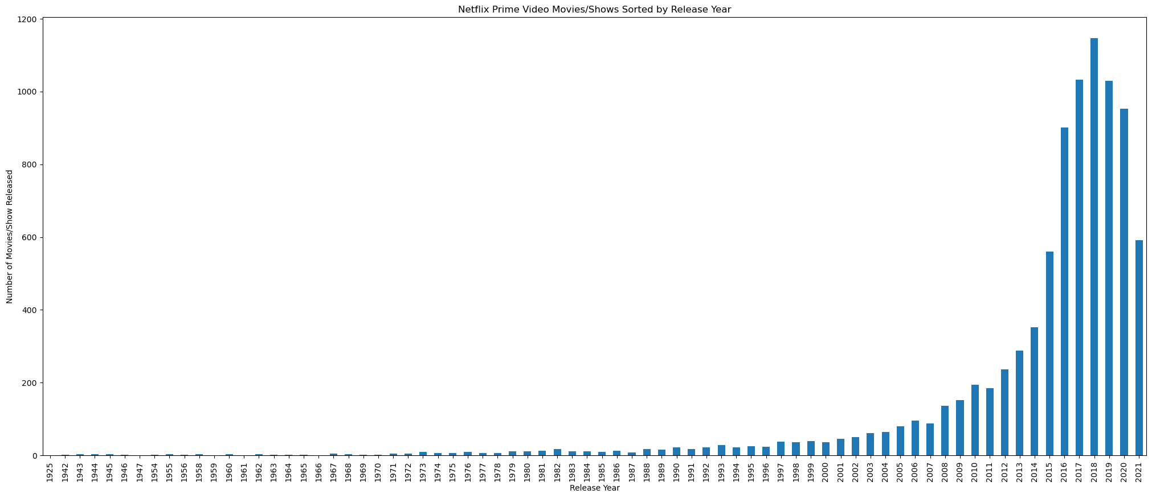
Quantity of movies by release date (omg it printed!)

Slide 4
Quantity of movies by release date
1,200
1,000
Number of Shows / Movies
500
200
1950
1970
1990
2005
2020
Year Released

Slide 5
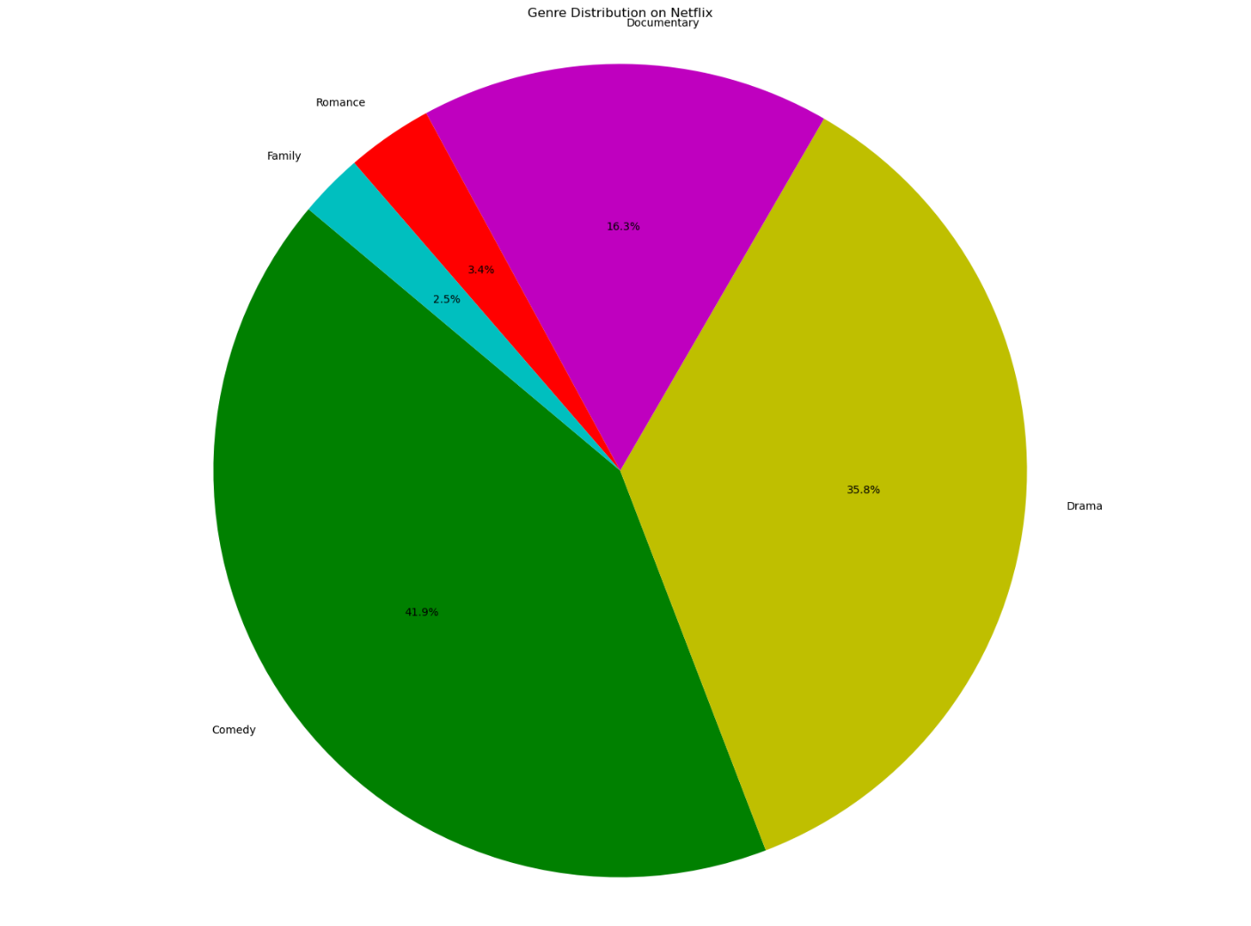
Most popular genres

Slide 6
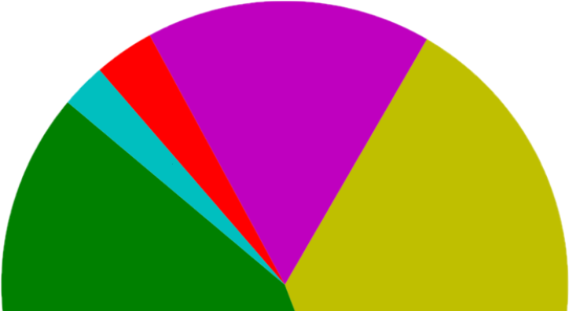
Most popular genres
Documentary
16.3%
Romance
3.4%
Family
2.5%
Comedy
41.9%
Drama
35.8%

Slide 7
Data sources selected
Kaggle → Netflix CSV & Rotten Tomatoes CSV
Data clean-up process
Netflix data was a well-organized CSV that gave basic facts
Rotten Tomatoes data was a large file
Column clean-up (renaming) for merging data

Slide 8
Approach taken on the project
This was great practice using past lessons on a blank slate
Past activities and assignments guided me in selecting the type of code I used
My goal was to get the most out of the two data frames and attempt to answer questions about a very large topic
How did we handle challenges?
We kept good communication on which data we were using
We decided to scale back and cut some of the datasets we looked at
We adjusted our question and objective once we saw the data we worked with

Slide 9
Reflections: What I’d do next time
Have the data before choosing the objective
Create a better execution plan going into the working groups
Collaborate more efficiently and make sure the project reflected a combination of the three parts
This was a big undertaking with a limited amount of time for completion. Our topic should have been narrower in scope.
My initial research prompted additional questions that would need a deeper dive…

Slide 10
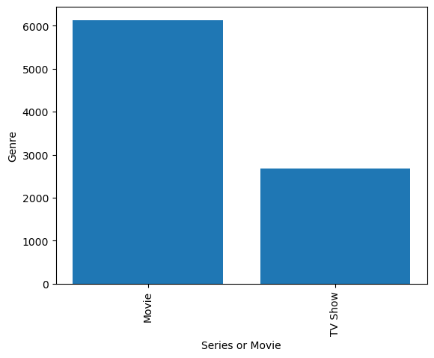
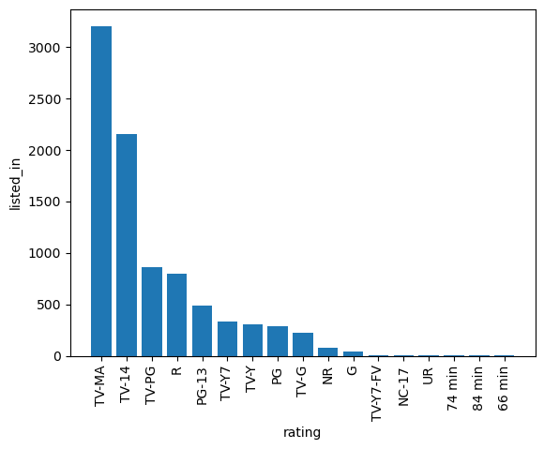
More research is needed
Movies vs Shows
Most common ratings

